Slide 1



Wikipedia Search Engine using various
Embedding Techniques
Presented By:
Group 33
Abhishek Nigam
Dhananjay Bagul
Rohit Kesarwani
Shambhavi Sharma
Sushil Kumar
Wilson Radadia
Presentation

Slide 2



Content
INTRODUCTION
MOTIVATION
PROBLEM STATEMENT
LITERATURE REVIEW
NOVELTY
METHODOLOGY
EVALUATION
RESULT
REFERENCES

Slide 3
INTRODUCTION
Wikipedia is a vast source of knowledge that provides information based on the user queries. However, searching for relevant articles is very challenging due to large amount of content available. Traditional keyword-based search engines fails to provide accurate results.
To overcome this challenge, this project aims to build a search engine for Wikipedia that uses various embedding techniques to improve the search experience by providing accurate and relevant results. User feedback will refine the search engine results continiously and enhance the performance over time.

Slide 4
MOTIVATION
Projects like the BERT-based Wikipedia search engine with user feedback are significant to design because almost every user goes through a pervasive problem while searching for information online.
By providing users feedback for the relevance of the results, we can create a more effective and interactive search experience on Wikipedia which makes it more useful for the users.
Natural language processing models like BERT can help improve search results accuracy by going through the hints given by the language and generating more accurate embeddings for text.

Slide 5

PROBLEM STATEMENT
The Project aims to design a Wikipedia based search engine using various embedding techniques. The goal is to provide users with accurate and relevant search results on the given query. User feedback to improve the performance continually and enhance the user experience over time.

Slide 6
Literature Review
Let’s start with discussing each paper
[1] " On Improving Wikipedia Search using Article Quality"
This paper proposed a framework that re-ranks search results based on article quality based on two development quality measurement models, namely Basic and PeerReview, based on co-authoring data gathered from articles' edit history.
[2] "Leveraging BERT for Extractive Text Summarization on Lectures"
This paper proposes a mechanism for extractive summarization through the use of K-Means clustering algorithm and the BERT model for text embeddings to find the closest sentences.

Slide 7
[3] “NLP based Intelligent News Search Engine using Information Extraction from e-Newspapers”
In order to extract pertinent news articles from online newspapers, this study suggests an NLP-based intelligent news search engine. The approach seeks to enhance standard keyword-based search engines' effectiveness and accuracy.
[4] "Sarcasm Detection in Tweets with BERT and GloVe Embeddings”
This paper proposes a sarcasm detection model for tweets using both BERT and GloVe embeddings. The model achieved high accuracy by combining the strengths of both approaches and can be applied to various NLP tasks that involve sarcasm detection.
[5] "Using of Jaccard Coefficient for Keywords Similarity"
This study investigates how the Jaccard coefficient can be used to quantify keyword similarity. The authors advise using this method for information retrieval and other NLP tasks after proving its efficacy in a number of studies.

Slide 8
[6] “ Passage re-ranking with bert”
This paper proposes a passage re-ranking approach using BERT, which aims to improve the accuracy of traditional information retrieval systems. The authors demonstrate the effectiveness of the proposed method in various experiments and suggest its potential use in practical applications.
[7] "A survey on word embedding techniques and semantic similarity for paraphrase identification"
Embedding methods and semantic similarity measurements used for paraphrase identification are surveyed in this work. The authors outline the benefits and drawbacks of various strategies and make suggestions for further study in this area.

Slide 9
NOVELTY
To improve the search results, users can give the feedback for each search result whether it is relevant or not. Based on the user feedback, refine the search engine results continiously and enhance the performance over time.

Slide 10
Data Collection
Data Preprocessing
Embedding Generation
Search using the Embeddings
User Feedback
METHODOLOGY

Slide 11
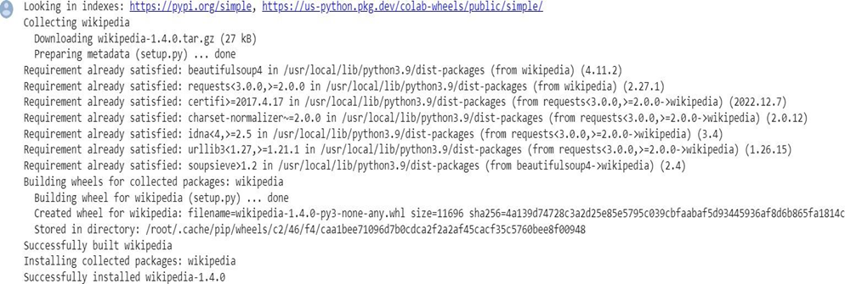
METHODOLOGY
Data Colllection & Preprocessing
The data is collected using the Wikipedia API.
The text data obtained from the API is preprocessed by removing the HTML tags, punctuations, stop words, and numbers.
Your paragraph text
text

Slide 12
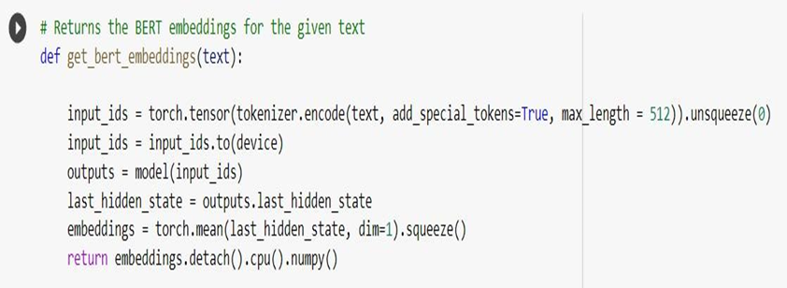
METHODOLOGY
Embedding Generation
The preprocessed text data is fed into the BERT model to generate contextualized word embeddings.
These embeddings capture the contextual meaning of the words in the documents, which is useful for measuring their similarity.

Slide 13
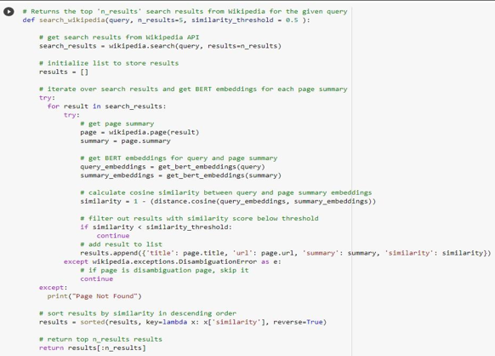
METHODOLOGY
Search using the Embeddings:
Here cosine similarity is calculated between the query embedding and the embeddings of each document.
The documents with the highest cosine similarity scores are considered the most relevant and are returned as search results.

Slide 14
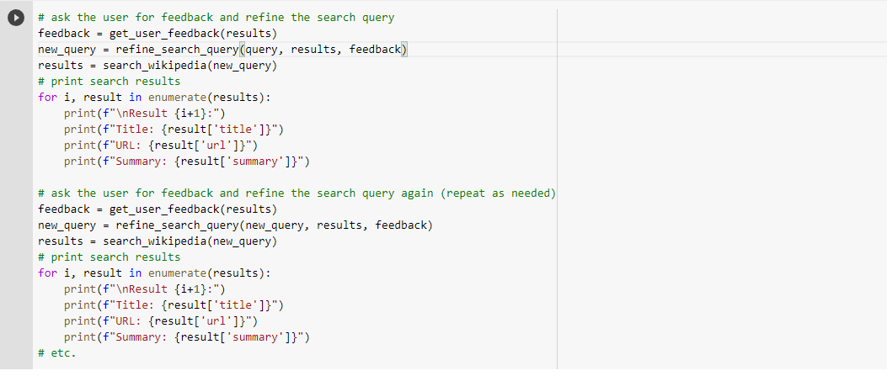
METHODOLOGY
User Feedback:
Based on the user feedback, refine the search results for further queries of the users.

Slide 15
EVALUATION
To evaluate the performance of the search engine, we calculate :
Precision
Recall
F1-Score
Accuracy
MAP (Mean Average Precision)
MRR (Mean Reciprocal Rank)
Query: Narendra Modi
Evaluation Metric
TF-IDF
BERT
Precision
0.20
0.4
Recall
1.0
0.57
F1-Score
0.33
1.0
Accuracy
0.0
1.0
MAP
0.0
0.83
Note: The evaluations are based on the titles of the documents retrieved.
MAR
0.0
1.0

Slide 16
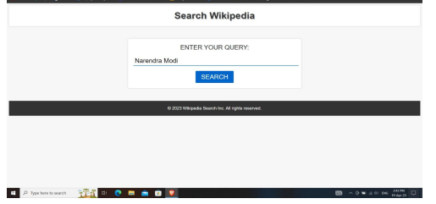
RESULT
It is the home page in which we just need to write the query
and click on search to get the results for the query.

Slide 17
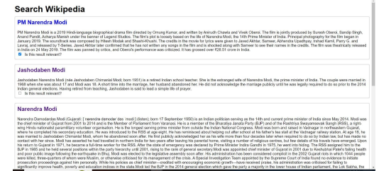
The results of the entered query by user are shown in the list form and also a checkbox is given for each result which is used as user feedback

Slide 18
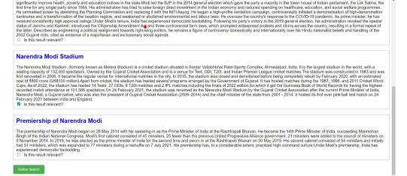
There is a button for refined search which will process the
results according to the user feedback.

Slide 19
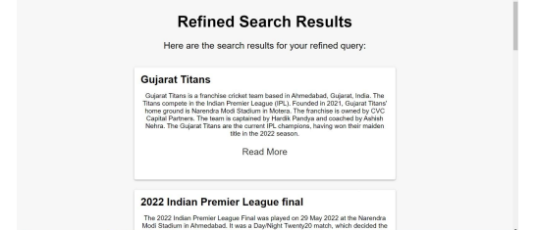
The refined search results are shown

Slide 20
REFERENCES
[1] S. Niwattanakul, J. Singthongchai, E. Naenudorn, and S. Wanapu, “Using of Jaccard Coefficient for Keywords Similarity,” Hong Kong, 2013.
[2] A. Khatri and P. P, “Sarcasm Detection in Tweets with BERT and GloVe Embeddings,” in Proceedings of the Second Workshop on Figurative Language Processing, Online: Association for Computational Linguistics, 2020, pp. 56–60. doi: 10.18653/v1/2020.figlang-1.7.
[3] R. Nogueira and K. Cho, “Passage Re-ranking with BERT.” arXiv, Apr. 14, 2020. Accessed: Apr. 19, 2023. [Online]. Available: http://arxiv.org/abs/1901.04085
[4] M. Hu, E.-P. Lim, A. Sun, H. W. Lauw, and B.-Q. Vuong, “On Improving Wikipedia Search using Article Quality” vol. 5, no. 1, p. 36, 2019.
[5] M. Kanakaraj and S. S. Kamath, “NLP based intelligent news search engine using information extraction from e-newspapers,” in 2014 IEEE International Conference on Computational Intelligence and Computing Research, Coimbatore, India: IEEE, Dec. 2014, pp. 1–5. doi: 10.1109/ICCIC.2014.7238500.
[6] D. Miller, “Leveraging BERT for Extractive Text Summarization on Lectures” arXiv preprint arXiv:1906.04165, 2019..
[7] D. R. Kubal and A. V. Nimkar, “A survey on word embedding techniques and semantic similarity for paraphrase identification,” IJCSYSE, vol. 5, no. 1, p. 36, 2019, doi: 10.1504/IJCSYSE.2019.098417.

Slide 21


Thank you!

